Slide 1







FakeBlock
DeepFake, its impacts,
and a way to combat them

Slide 2

FAKE NEWS?
As a result of this trending term in the media lately, the legitimacy of articles and news reports has come into question.

Slide 3
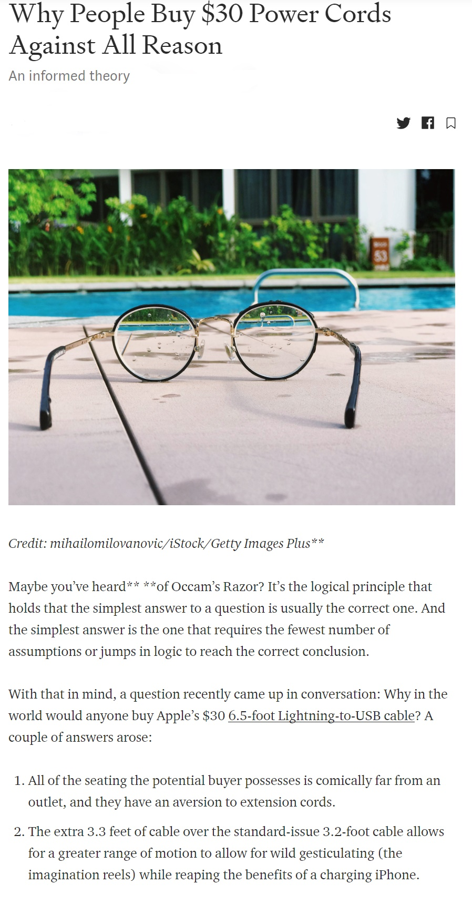
Is this real?
How can you be sure?

Slide 4
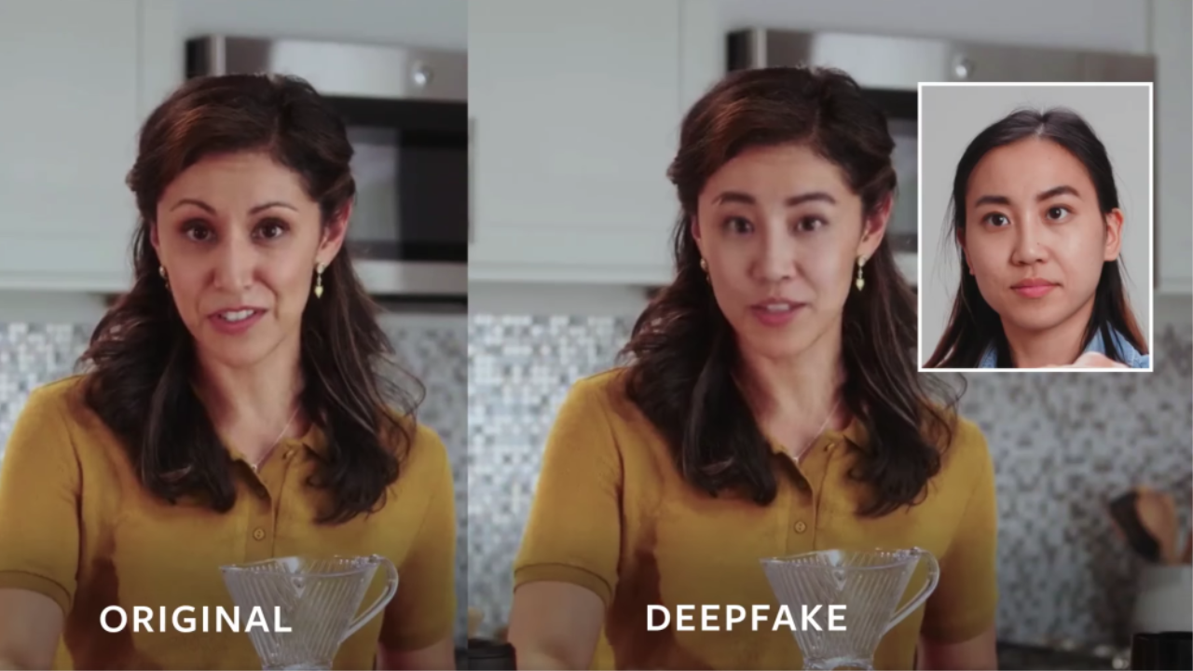
Video and audio files are considered a viable proof in most cases
This is about to change because of Deep Fakes

Slide 5
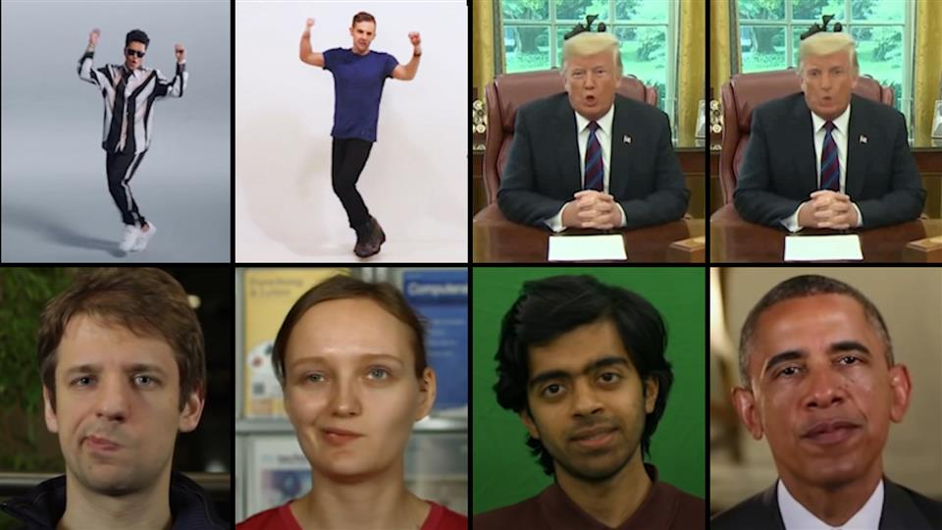
What are Deep Fakes?
The name “deep fake” comes from a combination of “deep learning” and “fake news”
Often used to fake a famous person’s speech, deepfakes are created by feeding large quantities of video and audio files with that person to a neural network to create a “filter” that could be applied to any recorded face to make it look like the targeted person

Slide 6
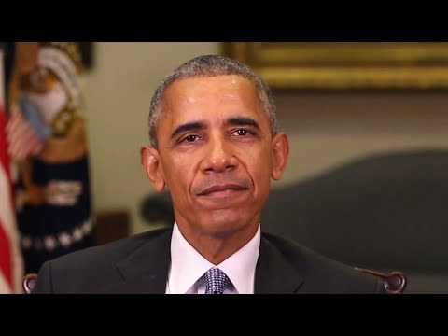


Slide 7
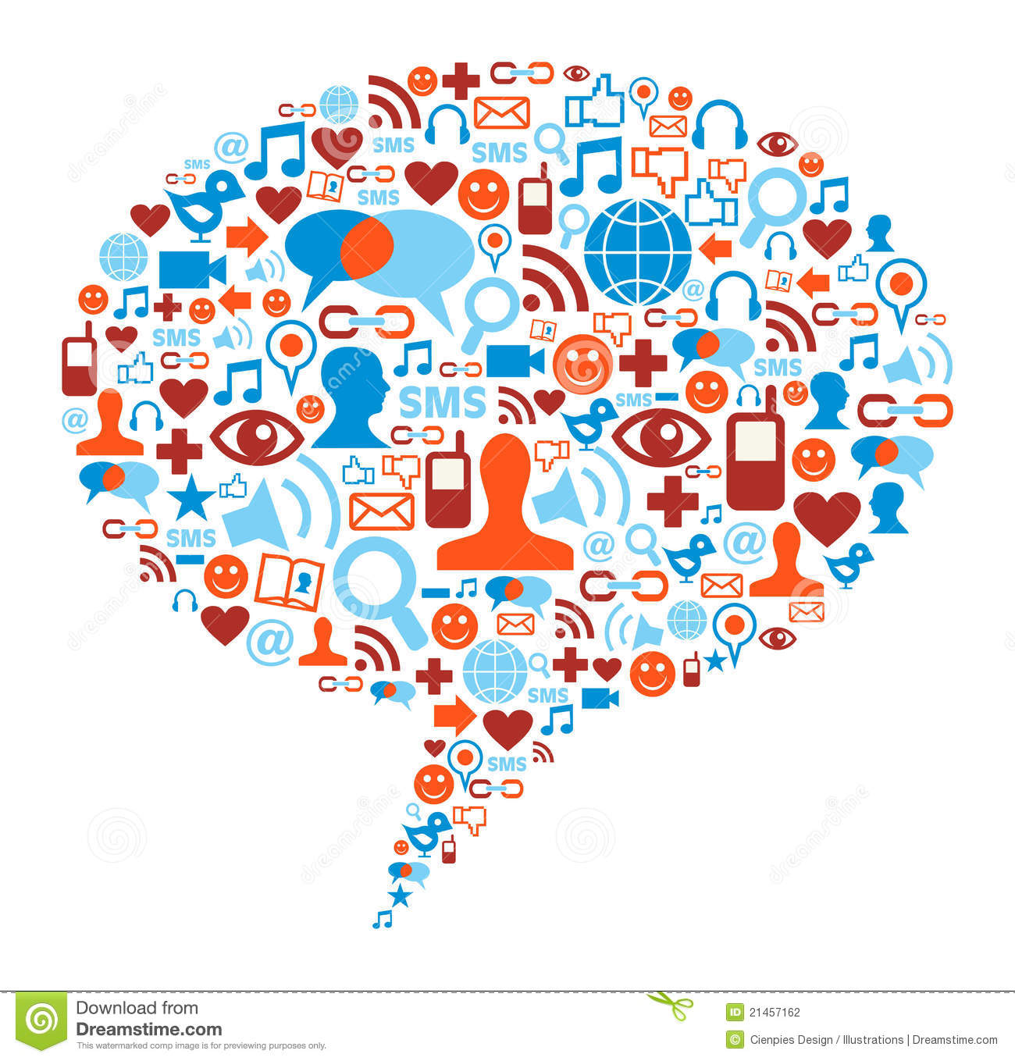
Deep Fakes Threaten the Truth
Videos like these seem real, but in reality, they can be forged to give bad publicity to important figures such as Barack Obama.
This seemingly unaltered video could then be reported on by a generally trusted and well-known news source, further propagating the falsities it was intended to spread.

Slide 8

Anyone can create fake videos
With Machine Learning, this process can be made accessible to anyone and can even be automated.

Slide 9
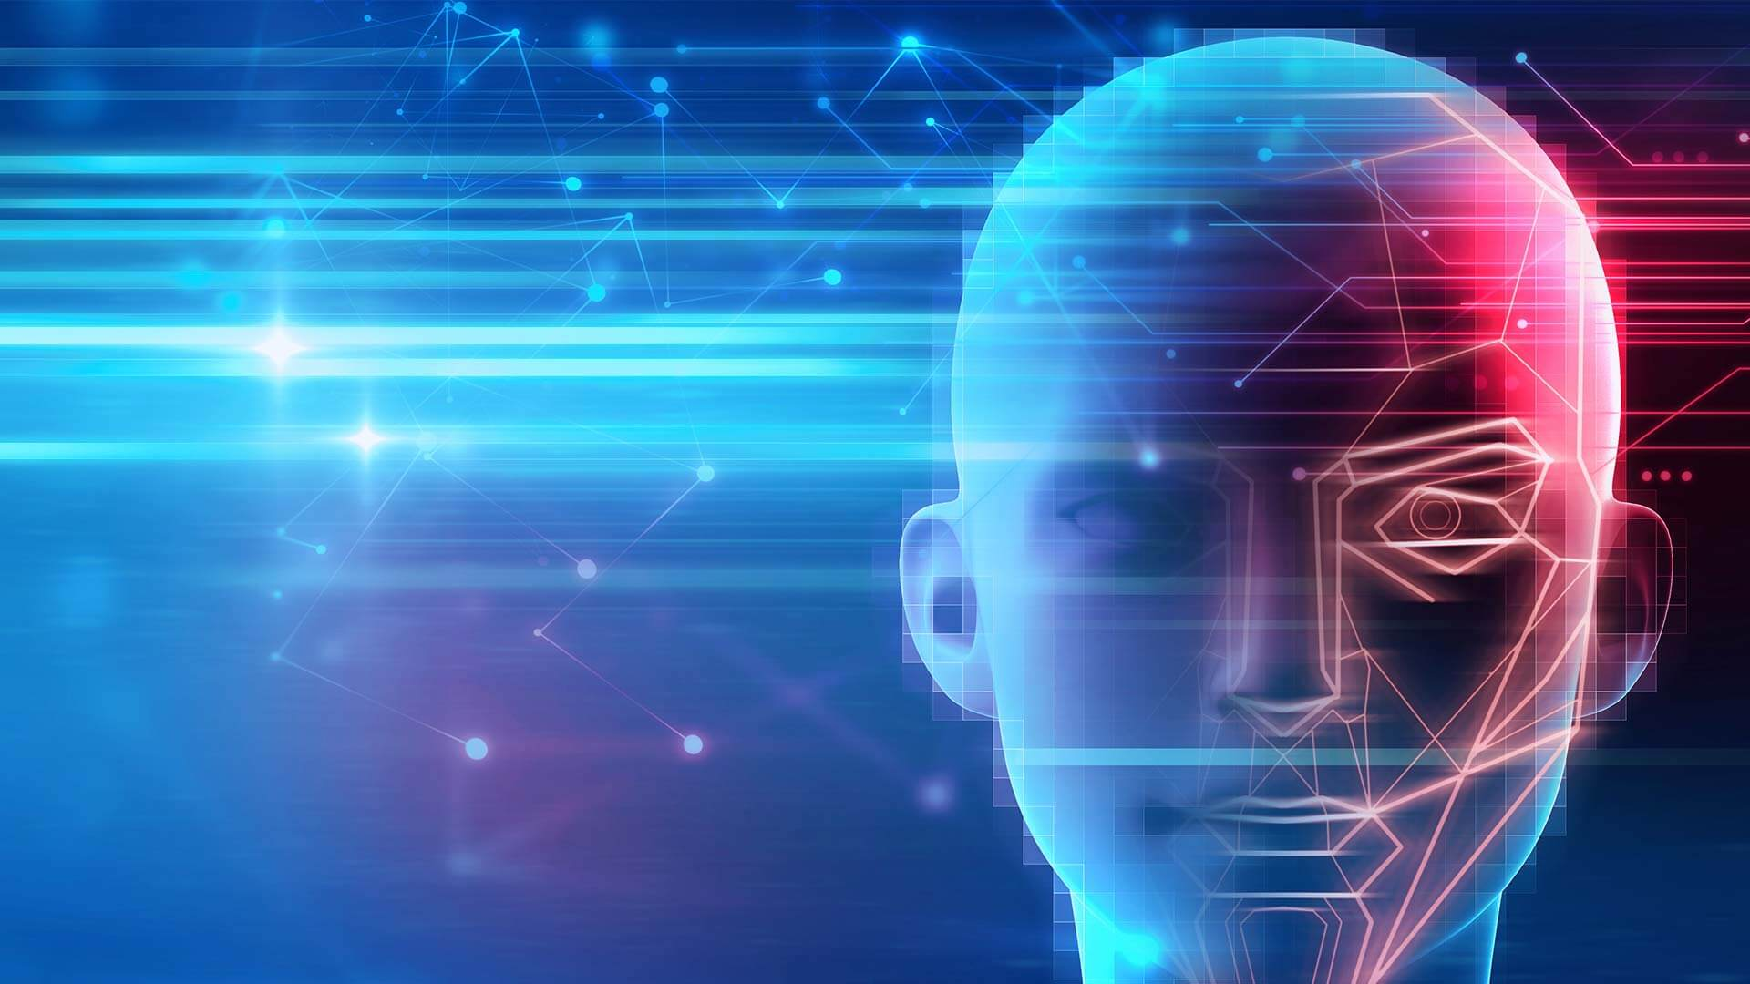
Fight 🔥 with 🔥
Introducing FakeBlock
A program which detects if an article contains AI-generated content

Slide 10

FakeBlock:
We propose to market a service, FakeBlock, that detects whether what you see online is real or fake.
It would work as a browser extension similar to AdBlock but for fake news.
The extension itself scans the webpage for text and pictures that include faces, then uses a neural network to predict if the site’s text or pictures were created by artificial intelligence.

Slide 11
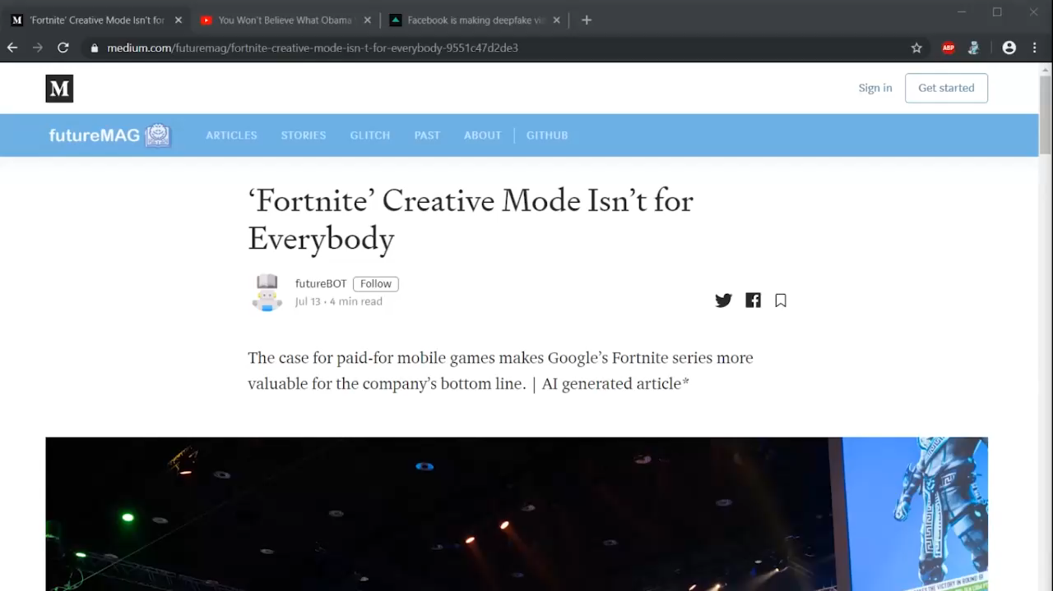

Slide 12








How FakeBlock Works:
Utilizes two types of Neural Network

Slide 13
DeepFake Detection
Utilizes an Xception neural network
Trained on Google’s FaceForensics++ Dataset to classify deepfakes from real images
Achieves 80% accuracy on compressed images / videos, up to 99%

Slide 14
AI Article Detection
Essentially reversed neural network text generation
Uses a gpt-2 neural network to determine probability of a neural network generating a certain sequence of text
Determine the probability that a neural network would generate text similar to our input and use that for our analysis

Slide 15
Code available at:
github.com/sirmammingtonham/FakeBlock

Slide 16
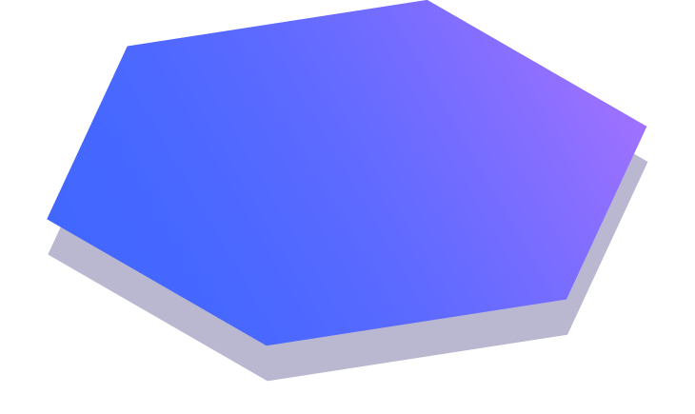
Thanks!
Any questions?

